Slide 1


Basics of
Synaptic Transistor
경북대학교 MENLAB 2025000422 최민수
26.01.04 MENLAB MEETING

Slide 2
Contents
Introduction
- Emerging Neuromorphic systems
- Architecture of the Synapse devices
- Materials of Photo-Synaptic Transistor
- Persistent-Photoconductivity (PPC)
2. Neuromorphic Hardware System
- Artificial Neuron
- Leaky Integrate-and-Fire (LIF) model
- Synaptic Plasticity
- Performance Indicators of an Artificial Synapse

Slide 3
Introduction

Slide 4
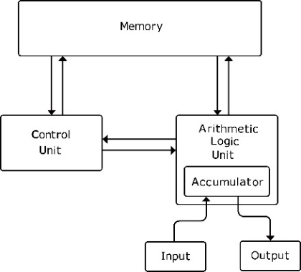

Emerging Neuromorphic systems
Neuromorphic systems, which conduct “in-memory” computing, simultaneously perform computations and data processing.
von Neumann bottleneck
Artificial Intelligence (AI)
+
ACS Appl. Electron. Mater. 2022, 4, 1427−1448
https://www.kairnews.com/news/438729

Slide 5
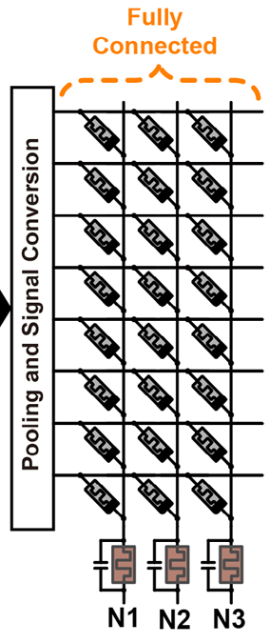
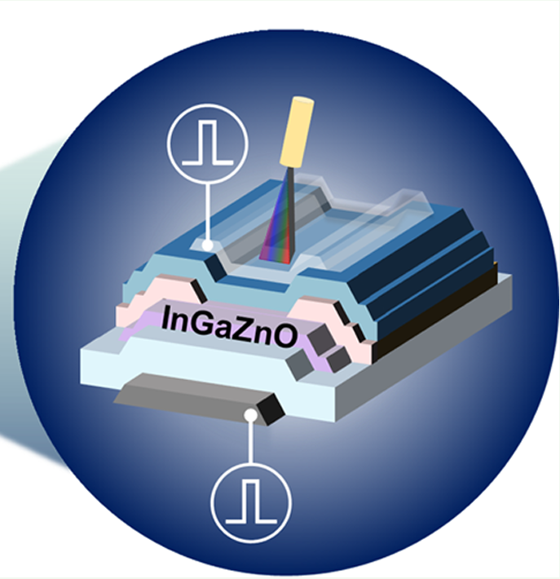
Architecture of the Synapse devices
Initial
Current
Thin Film Transistor
Conductance variation
Analog multilevel
+ Nonvolatile or Semivolatile
ex) Floating Gate, Ferroelectric, PPC
Three or more terminals
Online learning
Presynaptic Spike
→ Light pulse
Postsynaptic Spike
→ V_{GS} pulse
Output
I_{DS} (PSC)
Memristor Array
Resistance variation
Analog multilevel + Nonvolatile
Two-terminal
Offline learning
Presynaptic Spike
Voltage pulse
Postsynaptic Spike
Voltage pulse
Output
Postsynaptic Current (PSC)
ACS Appl. Electron. Mater. 2022, 4, 1427−1448
Li, Yibo, et al. "Review of memristor devices in neuromorphic computing: materials sciences and device challenges." Journal of Physics D: Applied Physics 51.50 (2018): 503002.

Slide 6
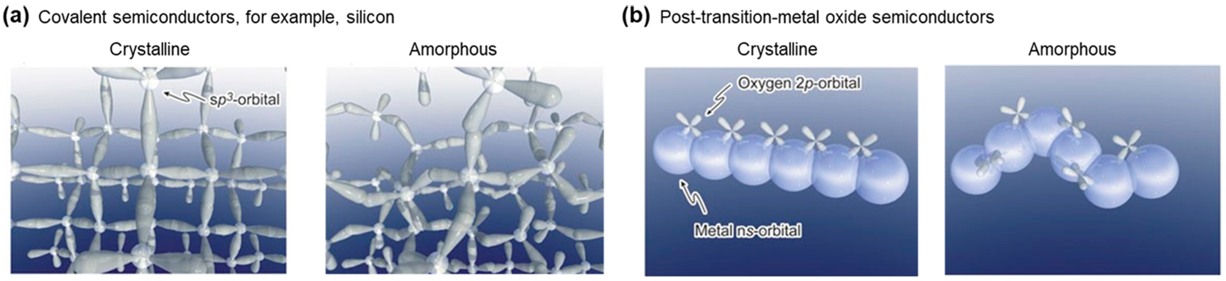
Materials of Photo-Synaptic Transistor
Amorphous Oxide Semiconductor (AOS)
→ Mature stage (Commercialized as n-type channel TFT)
+ High electron mobility in the amorphous phase
+ Lower leakage current due to wide bandgap energy
+ Persistent-Photoconductivity (PPC) effect
Silicon
High switching performance
Suitable for digital computing
ex) CMOS
2D materials
Immature stage
+ Poor uniformity
+ Low stability
Perovskite
Limited to solution process
+ Pb inclusion
+ Low stability
ACS Appl. Electron. Mater. 2022, 4, 1427−1448

Slide 7
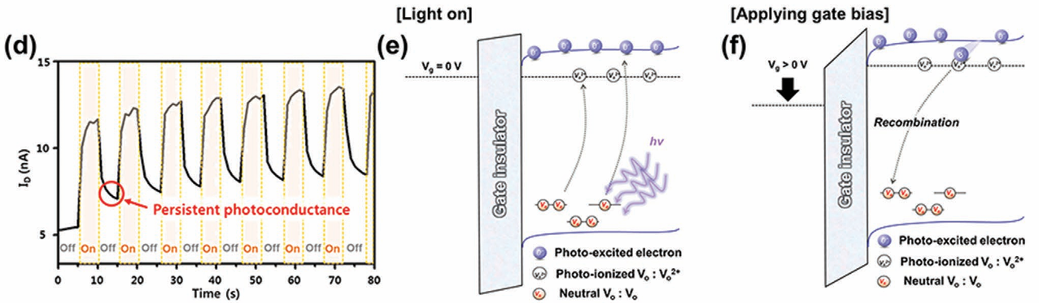

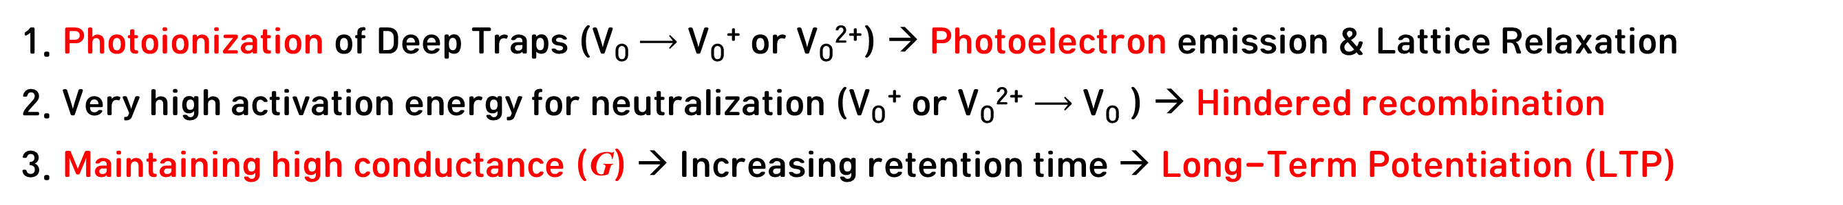
Persistent-Photoconductivity (PPC)
1. Photoionization of Deep Traps (V_{O} ⟶ V_{O}⁺ or V_{O}²⁺) → Photoelectron emission & Lattice Relaxation
2. Very high activation energy for neutralization (V_{O}⁺ or V_{O}²⁺ ⟶ V_{O} ) → Hindered recombination
3. Maintaining high conductance ($\text{G}$) → Increasing retention time → Long-Term Potentiation (LTP)
(d) PPC effect
(e)
Photonic input
Photoionization of V_{O}
Conductance variation
(f)
Applying +V_{GS} pulse
Alleviation of PPC
Long-term depression (LTD)/Reset
I_{DS}(0): Current at the onset of decay
β: Distribution of defects that control the decay process
τ: Relaxation time
Adv. Mater. 2021, 33, 2006091
ACS Appl. Electron. Mater. 2022, 4, 1427−1448

Slide 8
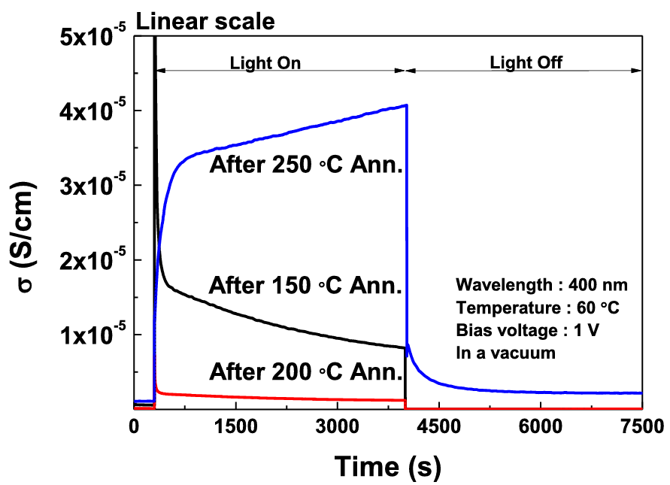
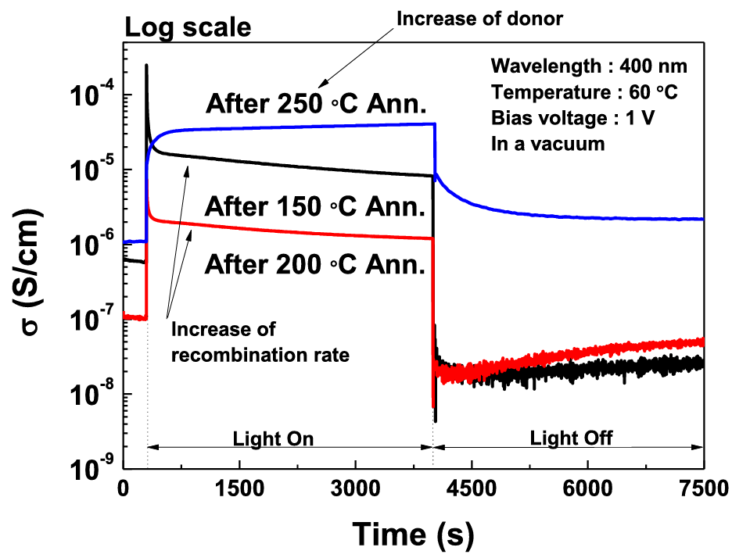
How to Increase PPC Duration
Applying -V_{GS} pulse → Suppress recombination
Sputtering process under low O₂ → Increase V_{O}
Post-annealing at high temperature → Increase V_{O}
Moon, Seung Jae, et al. "Photo response of a-IGZO thin films as a function of annealing temperature." Journal of Information Display (2025): 1-11.
ACS Appl. Electron. Mater. 2022, 4, 1427−1448

Slide 9
2. Neuromorphic Hardware System

Slide 10
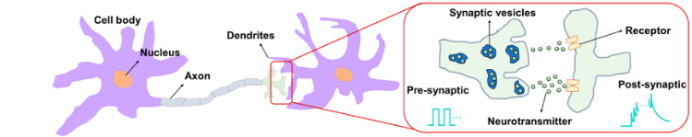
Artificial Neuron
Light
I_{DS} (PSC)
1. Dendrites: Receive signals from presynaptic axons and transmit them to the cell body (soma)
2. Soma: Spike generation occurs when presynaptic inputs exceed a specific threshold
3. Axon: A long fiber that conducts signals generated in the soma to the postsynaptic dendrites
4. Synapse: A junction between neurons that modulates and retains synaptic weight
Membrane: An insulating layer enclosing the soma that acts as a capacitor
Membrane potential: The electric potential of the membrane, which varies in response to input signals
Resting potential: The baseline membrane potential (reset) without stimulation (Biological: -V / Artificial: 0 V)
ACS Appl. Electron. Mater. 2022, 4, 1427−1448

Slide 11
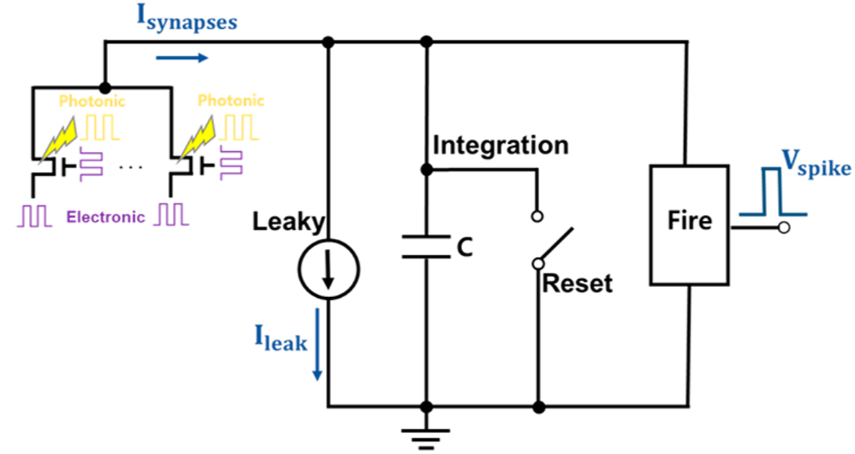
Leaky Integrate-and-Fire (LIF) model
LIF model: First reported as the IF model, the LIF neuron became the basis for artificial neurons
2. Raise the membrane potential above threshold
3. Fire an action potential (spike)
to the postsynaptic dendrites
1. Presynaptic inputs
5. Reset to resting potential
4. Time-dependent decay of membrane potential due to ion diffusion
ACS Appl. Electron. Mater. 2022, 4, 1427−1448

Slide 12
Synaptic Plasticity
Standards for synaptic plasticity modulation
: “External inputs”, “Temporal correlation between the input and output spikes”
Electronic
Photonic
Pressure
Temperature
Synaptic Plasticity
Memory retention time
Short-term plasticity
Long-term plasticity
Short-term depression (STD)
Short-term potentiation (STP)
Spike-rate-dependent plasticity
(SRDP)
Spike-timing-dependent plasticity
(STDP)
Ex) PPD
Ex) PPF
Long-term
depression / potentiation (LTD/LTP)
Long-term
depression / potentiation (LTD/LTP)
ACS Appl. Electron. Mater. 2022, 4, 1427−1448

Slide 13
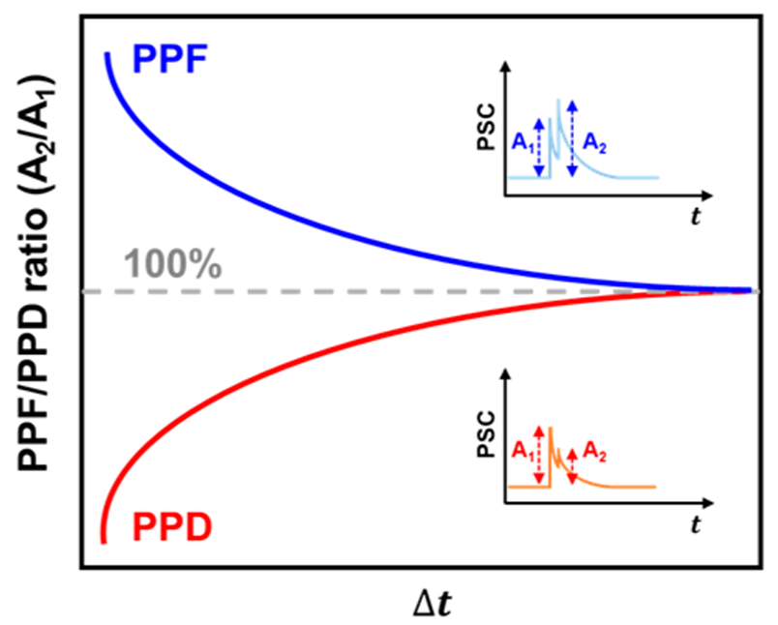
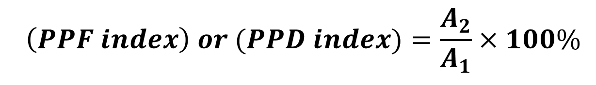
Short-Term Plasticity
Short-term plasticity, lasting milliseconds to minutes, underlies temporal information decoding
$$\left(PPF index\right) or (PPD index)=\frac{A_{2}}{A_{1}}×100\%$$
Paired-pulsed facilitation (PPF): A₁ < A₂
→
Paired-pulsed depression (PPD): A₁ > A₂
→
ms~ s
Decay
The former is a rapidly decaying function, and the latter is a slowly decaying one. (τ₁ < τ₂)
c₁, c₂ = initial facilitation amplitude / τ₁, τ₂ = relaxation time
ms~ s
Presynaptic spike interval
Q. 생물학적인 관점에서 PPF와 PPD는 어떻게 발현될까?
Ans. PPF: “연속으로 오면 중요한 것이므로, 더 크게 반응해라!” ex) 민감화(산에 혼자 있는데 풀숲 발자국 소리), 집중, 긴급 상황(공포 영화 감상), 단기 기억
PPD: “처음엔 강하게 반응하지만, 반복되면 무시한다.” ex) 적응(냄새 맡기), 피로, 에너지 절약, 노이즈 필터링
ACS Appl. Electron. Mater. 2022, 4, 1427−1448

Slide 14
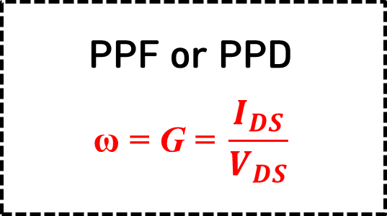
Actual Experiment of PPF/PPD
Polarity of Δω (PPF or PPD) depends on “A₁ - A₂”
Magnitude of Δω is modulated by the “Δt_{Light}”
Variable Setup
Ex) Δt_{Light}
Presynaptic Spike
Ex) 1st light pulse
Read Voltage
Ex) V_{DS} + V_{GS} pulse
PSC Measurement
Ex) A₁
PPF or PPD
$$\text{ω}\text{ = }\text{G}\text{ = }\frac{I_{DS}}{V_{DS}}$$
PSC Measurement
Ex) A₂
Read Voltage
Ex) V_{DS} + V_{GS} pulse
Presynaptic Spike
Ex) 2nd light pulse
ACS Appl. Electron. Mater. 2022, 4, 1427−1448

Slide 15
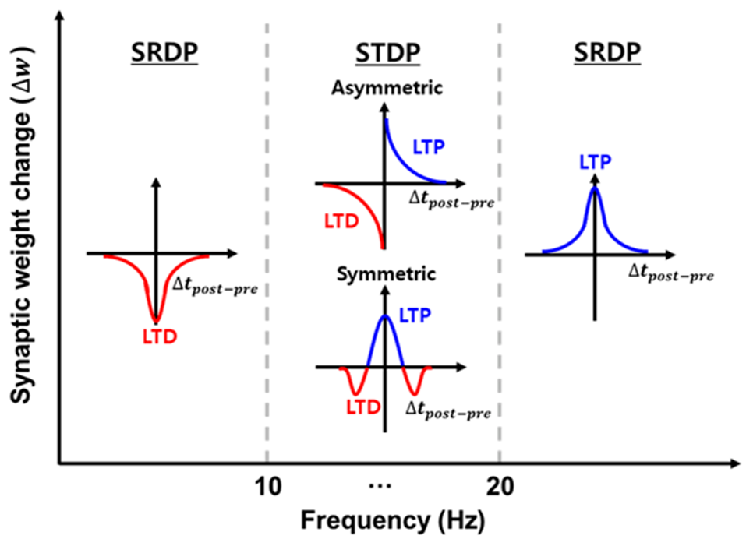
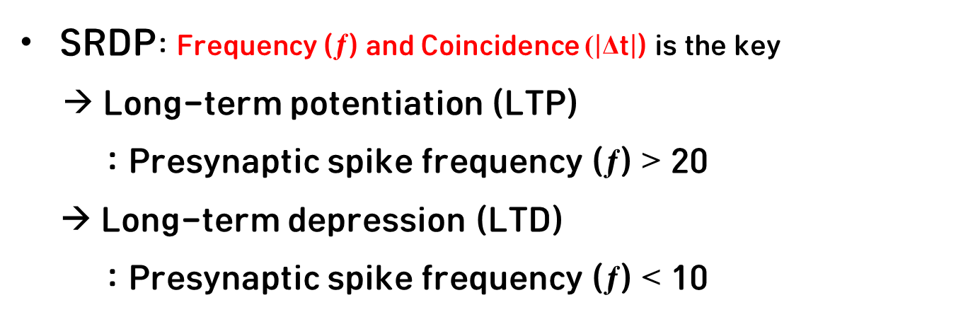
Long-Term Plasticity
Spike-rate-dependent plasticity
SRDP: Frequency (ƒ) and Coincidence ($\left|\text{Δ}\text{t}\right|$) is the key
→ Long-term potentiation (LTP)
: Presynaptic spike frequency (ƒ) > 20
→ Long-term depression (LTD)
: Presynaptic spike frequency (ƒ) < 10
Presynaptic spikes frequency
Q. 생물학적 관점에서, 신호의 빈도와 동시성에 의해 결정되는 SRDP를 왜 Long-term plasticity로 간주해야 할까?
Ans. 뇌는 “자주 반복되는 사건”에 대한 기억을 영구적으로 저장하려고 하기 때문
ACS Appl. Electron. Mater. 2022, 4, 1427−1448

Slide 16
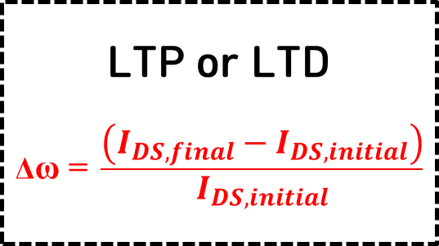
Actual Experiment of SRDP
LTP: At higher frequencies, PPC accumulates and the current increases rapidly
LTD: At lower frequencies, PPC discharges before it can accumulate, resulting in no change or a decrease
Variable Setup
Ex) ƒ, Δt_{Light}
Presynaptic Spikes
Ex) Light pulse train
Read Voltage
Ex) V_{DS} + V_{GS} pulse
Reset Voltage
Ex) High +V_{GS}
LTP or LTD
$$\text{Δ}\text{ω}\text{ = }\frac{\left(I_{DS, final}−I_{DS, initial}\right)}{I_{DS, initial}}$$
PSC Measurement
Ex) I_{DS, final}
Q. 메커니즘(초기 자극 + 후속 자극 → 전류 변화)을 고려하였을 때, STP와 SRDP는 거의 비슷하다. 그럼 PPF의 지속 시간이 늘어난 것이 LTP인가?
Ans. “Transition from STP to LTP”
STP는 2번의 펄스 이후 금방 reset되는 상태이고, LTP는 Light pulse가 반복되면 PPC가 누적되어 전류의 베이스라인 자체가 높아져 자연적으로 reset이 되지 않는 상태
ACS Appl. Electron. Mater. 2022, 4, 1427−1448

Slide 17
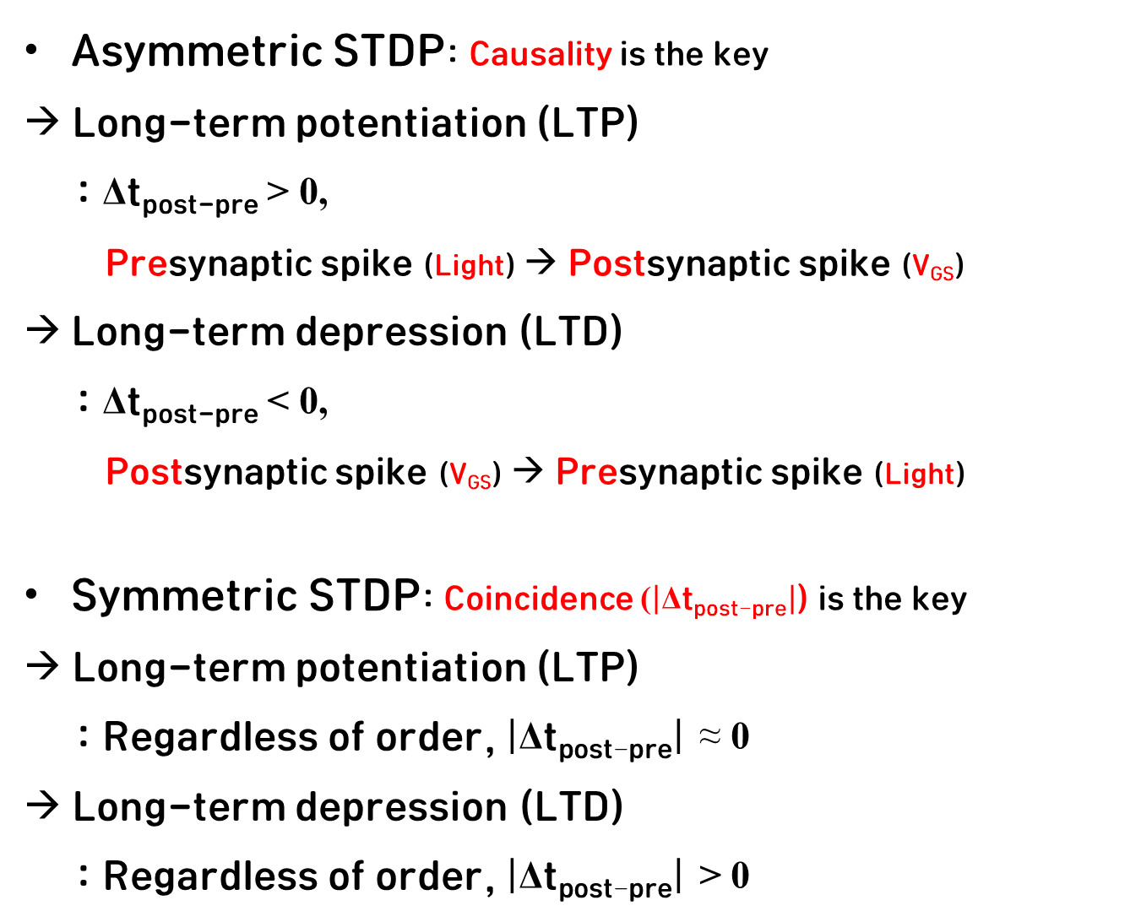
Long-Term Plasticity
Spike-timing-dependent plasticity
Asymmetric STDP: Causality is the key
→ Long-term potentiation (LTP)
: Δt_{post-pre} > 0,
Presynaptic spike (Light) → Postsynaptic spike (V_{GS})
Long-term depression (LTD)
: Δt_{post-pre} < 0,
Postsynaptic spike (V_{GS}) → Presynaptic spike (Light)
Symmetric STDP: Coincidence ($\left|\text{Δ}\text{t}\text{post}\text{−}\text{pre}\right|$) is the key
→ Long-term potentiation (LTP)
: Regardless of order, $\left|\text{Δ}\text{t}\text{post}\text{−}\text{pre}\right|$ ≈ 0
→ Long-term depression (LTD)
: Regardless of order, $\left|\text{Δ}\text{t}\text{post}\text{−}\text{pre}\right|$ > 0
Presynaptic spikes frequency
Q. 생물학적 관점에서, 신호의 순서에 의해 결정되는 Asymmetric STDP를 왜 Long-term plasticity로 간주해야 할까?
Ans. 뇌는 “원인과 결과가 시간적으로 연결되어 있을 때(인과 관계)”에 대한 기억을 영구적으로 저장하려고 하기 때문
ACS Appl. Electron. Mater. 2022, 4, 1427−1448

Slide 18
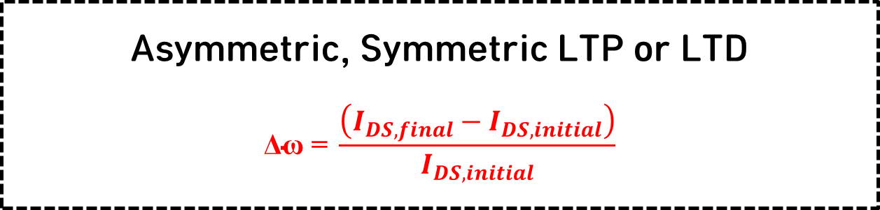
Actual Experiment of STDP
Variable Setup
Ex) ƒ, Δt_{post-pre}
Presynaptic-Postsynaptic Spike Pairing
Ex) Light pulse train (Pre) + V_{GS} pulse train (Post)
Read Voltage
Ex) V_{DS} + V_{GS} pulse
Reset Voltage
Ex) High +V_{GS}
Asymmetric, Symmetric LTP or LTD
$$\text{Δω}\text{ = }\frac{\left(I_{DS, final}−I_{DS, initial}\right)}{I_{DS, initial}}$$
PSC Measurement
Ex) I_{DS, final}
Δt_{post-pre} represents only the x‑axis, while the y‑axis (Δω) becomes STDP only when the pulse shape, amplitude, or device parameters are continuously tuned until the device responds as intended
ACS Appl. Electron. Mater. 2022, 4, 1427−1448

Slide 19
Anti-Hebbian Phenomenon in Experiments
Δt_{post-pre} > 0
PPC generation by pre-spike
PPC suppression
by post-spike
Conductance reduction
LTD
Anti-Hebbian
Δt_{post-pre} < 0
Reset
by post-spike
PPC generation by pre-spike
Conductance increase
LTP
Anti-Hebbian
Q. Anti-Hebbian 현상으로 인해 시냅스 가중치가 의도대로 형성되지 않는 문제를 극복하는 방법은 무엇이 있을까?
Ans. Pulse shaping: + V_{GS} 사각파 대신 양전압과 음전압이 섞인 사인파 or 삼각파 사용
ex) Δt_{post-pre} > 0 : 빛이 들어올 때 Post Spike의 앞부분(음전압 or 낮은 전압)과 Pairing → Hebbian Rule
ex) Δt_{post-pre} < 0 : 빛이 들어올 때 Post Spike의 뒷부분(높은 양전압)과 Pairing → Hebbian Rule
Campbell, Kristy A., Kolton T. Drake, and Elisa H. Barney Smith. "Pulse shape and timing dependence on the spike-timing dependent plasticity response of ion-conducting memristors as synapses." Frontiers in bioengineering and biotechnology 4 (2016): 97.
ACS Appl. Electron. Mater. 2022, 4, 1427−1448

Slide 20
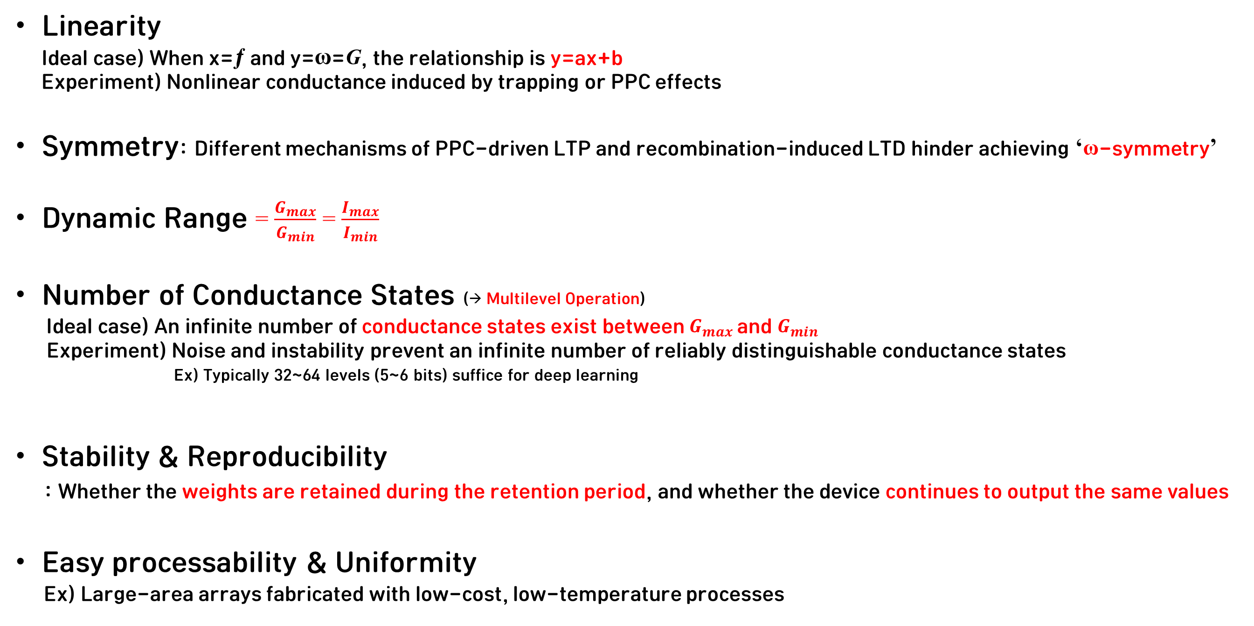
Performance Indicators of an Artificial Synapse
Linearity
Ideal case) When x=ƒ and y=ω=$\text{G}$, the relationship is y=ax+b
Experiment) Nonlinear conductance induced by trapping or PPC effects
Symmetry: Different mechanisms of PPC‑driven LTP and recombination‑induced LTD hinder achieving ‘ω-symmetry’
Dynamic Range = $\frac{G_{max}}{G_{min}}$ = $\frac{I_{max}}{I_{min}}$
Number of Conductance States (→ Multilevel Operation)
Ideal case) An infinite number of conductance states exist between $G_{max}$and $G_{min}$
Experiment) Noise and instability prevent an infinite number of reliably distinguishable conductance states
Ex) Typically 32–~64 levels (5~–6 bits) suffice for deep learning
Stability & Reproducibility
: Whether the weights are retained during the retention period, and whether the device continues to output the same values
Easy processability & Uniformity
Ex) Large‑area arrays fabricated with low‑cost, low‑temperature processes
ACS Appl. Electron. Mater. 2022, 4, 1427−1448

